Slide 1
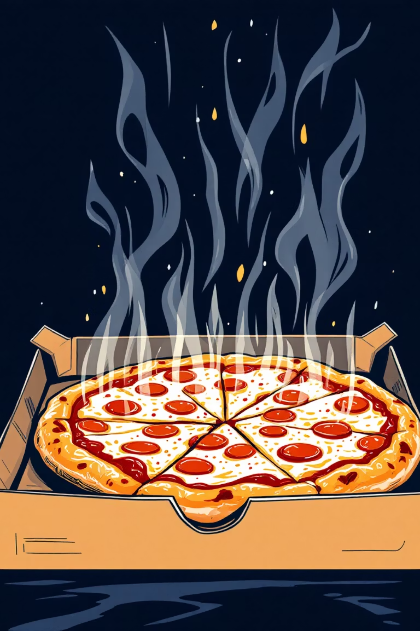
Pizza Sales Analysis
Comprehensive KPI and sales performance review for operations managers and sales analysts, covering revenue trends, customer behavior patterns, and strategic optimization opportunities across our pizza chain network.

Slide 2
Executive Summary: Strong Foundation with Growth Opportunities
$817.86K
21,350
$38.31
2.32
Total Revenue
Total Orders
Average Order Value
Pizzas Per Order
Annual performance demonstrates healthy market position
Consistent customer engagement throughout the year
Solid baseline with room for premium positioning
Multi-pizza ordering indicates family and group purchases
Our pizza chain delivered robust performance in 2015 with balanced category distribution and clear customer preferences. The data reveals strong weekend demand patterns, seasonal opportunities in summer months, and significant potential for revenue optimization through premium positioning and underperformer elimination.
Key operational strengths include consistent order volume across quarters, balanced portfolio with no single category dependency, and healthy multi-pizza ordering behavior suggesting family-oriented customer base. Strategic focus areas include weekend staffing optimization, premium product positioning, and decisive menu rationalization.

Slide 3
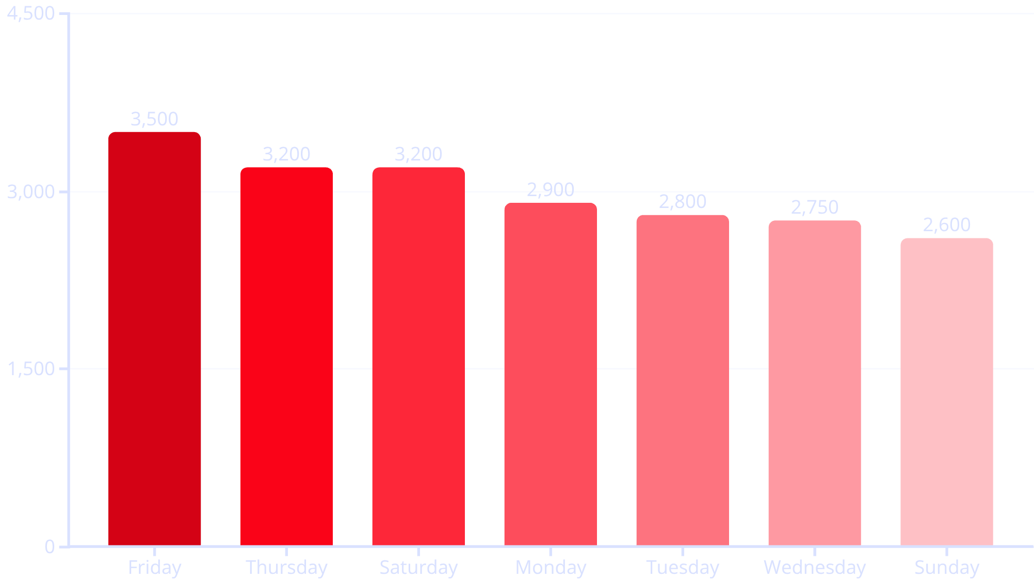
Weekly Demand Patterns: Weekend-Driven Business Model
Strategic Insights
Friday emerges as our peak performance day with 3,500 orders, representing 35% higher demand than Sunday's 2,600 orders. This pattern reflects weekend preparation behavior and social dining preferences.
Thursday and Saturday tie at 3,200 orders each, creating a strong three-day peak period that generates 47% of weekly revenue. Sunday shows the lowest demand, indicating customer recovery after weekend social activities.
Operational Impact: Weekend-focused demand requires strategic staffing increases Friday through Saturday, with potential cost savings on Sunday shifts.

Slide 4
Seasonal Revenue Trends: Summer Peak Performance
January Strong Start
Summer Peak
1,845 orders - New Year dining resolutions and winter comfort food demand drive solid Q1 performance with healthy post-holiday recovery.
July achieves highest monthly performance at 1,935 orders - vacation season, outdoor gatherings, and convenience dining drive 18% premium vs. low months.
1
2
3
4
Spring Growth
Fall Decline
May delivers 1,853 orders showing spring season strength with warmer weather encouraging social dining and family gatherings.
September-November range of 1,646-1,680 orders represents post-summer adjustment as customers return to regular dining routines and school schedules.
The 18% variance between peak July (1,935) and trough months (1,646-1,680) presents clear seasonal marketing opportunities. Summer campaigns should capitalize on vacation and outdoor dining trends, while fall months require targeted promotions to maintain momentum. Winter strength in January suggests effective holiday marketing carry-over effects.

Slide 5
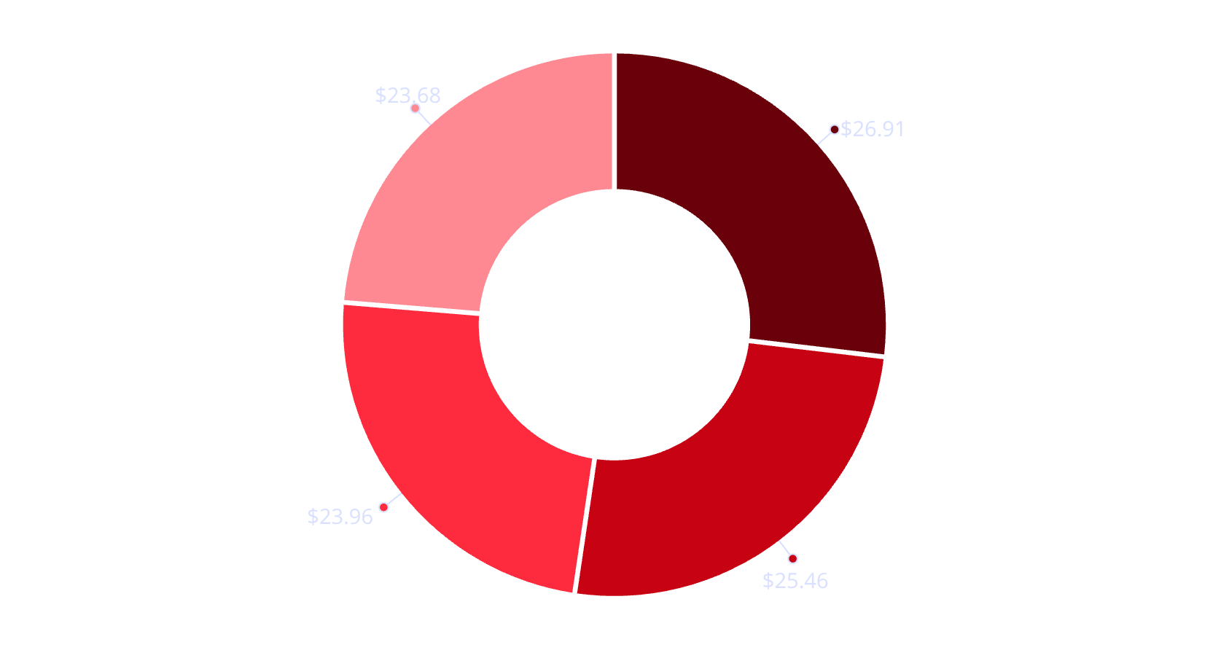
Product Portfolio Analysis: Balanced Category Performance
Portfolio Strength Indicators
Our category distribution demonstrates exceptional balance with no single category creating dependency risk. Classic pizzas lead at 26.91%, followed closely by Chicken at 25.46%, creating healthy competition between traditional and protein-focused options.
Supreme and Veggie categories at 23.96% and 23.68% respectively show strong premium and health-conscious market penetration. This distribution indicates successful diversification strategy appealing to various customer preferences.
Classic dominance reflects customer loyalty to traditional flavors
Strong chicken performance indicates protein preference trends
Classic
Chicken
Supreme
Veggie
Healthy veggie segment suggests untapped premium potential
Supreme category validates customer willingness to pay for premium options
The minimal 3.23% spread between highest and lowest performing categories creates operational stability while providing clear growth vectors. Focus areas include leveraging Classic category strength for premium variants and optimizing Chicken category performance to match its market share potential.

Slide 6
Size Preference Analysis: Large Pizza Dominance
Large Pizzas
Medium Pizzas
45.89% Market Share
30.49% Market Share
Family and sharing preference drives nearly half of all orders. Strong indicator of group dining behavior and value-seeking customers who prefer larger portions for better per-slice pricing.
Individual and couple sizing represents solid secondary market. Perfect for date nights, small families, or customers seeking portion control without sacrificing variety.
Small Pizzas
Extra Large
21.77% Market Share
1.72% Market Share
Personal and kids portions serve niche but important market segment. Includes lunch customers, children's meals, and appetizer orders for larger group dining occasions.
Niche premium segment for special occasions, large groups, or customers seeking maximum value. Low volume but potentially high-margin opportunity for special promotions.
Large pizza dominance at 45.89% aligns perfectly with our 2.32 pizzas per order average, confirming family-oriented customer base. This presents clear upselling opportunities to move medium customers toward large sizes, and small customers toward medium, potentially increasing average order value significantly. The minimal XL segment suggests opportunity for special occasion marketing and party packaging.

Slide 7

Revenue Champions: Premium Positioning Success
01
Thai Chicken & Barbecue Champions
Both generate $43K revenue, demonstrating customer appetite for premium Asian fusion and classic barbecue flavors. These items command higher prices while maintaining strong order frequency at 2.3K orders each, indicating successful premium positioning without demand sacrifice.
02
California Performance
$41K revenue positions this West Coast-style pizza as third-place performer. Premium ingredients and unique flavor profile resonate with customers seeking upscale dining experience, validating regional specialty approach.
03
Classic & Spicy Italian Foundation
$38K and $35K respectively show traditional options maintain revenue strength. Classic Deluxe leads volume at 2.5K quantity while generating solid revenue, proving customer loyalty to enhanced traditional recipes.
04
Volume-Revenue Gap Analysis
High-volume items don't always translate to highest revenue, revealing pricing optimization opportunities. Classic Deluxe's 2.5K quantity with moderate revenue suggests potential for premium pricing on popular items.
The revenue leadership of Thai Chicken and Barbecue validates our premium positioning strategy while maintaining healthy order volumes. This success pattern suggests expanding Asian fusion offerings and enhancing classic favorites with premium ingredients. The consistent 2.3-2.4K order range across top performers indicates optimal market positioning without overpricing.

Slide 8
Underperformer Analysis: Menu Optimization Opportunities
Brie Carre: Critical Underperformer
Mediterranean & Spinach Struggles
Revenue: $12K (lowest) | Quantity: 490 | Orders: 480
Revenue Range: $14K-16K | Pattern: Consistent weakness
Dramatic underperformance across all metrics suggests niche premium positioning failed to resonate with customer base. Consider immediate discontinuation or complete reformulation with more accessible ingredients while maintaining upscale positioning.
Health-focused options underperforming despite growing wellness trends. May require flavor enhancement, ingredient upgrades, or repositioning as "fresh & flavorful" rather than purely health-focused to broaden appeal beyond health-conscious segment.
Green Garden Options
Order Frequency Gap
Revenue: $14K | Volume: 900-960 range
Bottom Range: 480-918 orders vs. Top Range: 2,300+ orders
Vegetable-heavy pizzas struggle with revenue generation despite reasonable order frequency. Consider adding protein options, premium cheese upgrades, or repositioning as "garden fresh" with enhanced flavor profiles to increase per-pizza value.
Significant performance gap indicates these items lack mass appeal. Priority should be given to reformulation or elimination to focus resources on higher-performing options and reduce operational complexity.
Bottom five performers show consistent weakness across revenue, volume, and order frequency metrics. The 480-918 order range represents less than 40% of top performer volumes, indicating fundamental market mismatch. Immediate action required includes discontinuing Brie Carre, reformulating health-focused options with enhanced flavors, and conducting market research on vegetarian preferences before continuing investment in underperforming vegetable-based options.

Slide 9



Strategic Recommendations: Revenue Optimization Framework
Operational Excellence
Product Strategy
Revenue Enhancement
Weekend Staffing: Increase Friday staff by 35% to handle peak demand. Optimize Thursday-Saturday scheduling for 47% weekly revenue concentration.
Premium Expansion: Develop additional Asian fusion options following Thai Chicken success. Create premium classic line with enhanced ingredients.
Pricing Optimization: Increase prices on high-volume items like Classic Deluxe. Leverage Thai Chicken and Barbecue price tolerance for further premium positioning.
Seasonal Campaigns: Deploy targeted July promotions capitalizing on vacation dining. Build inventory for January and summer peaks.
Menu Rationalization: Discontinue bottom 5 performers starting with Brie Carre. Reformulate health options with enhanced flavors.
Upselling Programs: Target 2.5+ pizzas per order from current 2.32 average through bundle promotions and family meal deals.
Implementation timeline should prioritize immediate menu optimization (30 days), followed by pricing adjustments (60 days), and seasonal campaign development (90 days). Key success metrics include average order value increase from $38.31 to $42+, reduction of underperformers from 5 to 2 items, and maintenance of 2.32+ pizzas per order while increasing premium mix percentage.

Slide 10



Key Performance Monitoring & Success Indicators
Critical KPIs for Monthly Review
Revenue Per Pizza: Track pricing optimization success across categories
Category Mix Health: Monitor Classic vs Premium category ratios for portfolio balance
35%
Order Value Growth: Focus on increasing $38.31 average through strategic upselling
Underperformer Turnaround: Set 90-day improvement targets or elimination deadlines
Weekend Performance: Track Thursday-Saturday revenue concentration trends
Success Target: Achieve $42+ average order value while reducing menu complexity and maintaining customer satisfaction scores above 85%
Friday Premium
Track weekly revenue velocity using Friday performance as leading indicator for seasonal and promotional success
Bottom Line: Strong operational foundation with clear premium opportunities and decisive underperformer elimination needed for optimal profitability.
Focus on weekend operational excellence, premium product positioning, and data-driven menu optimization to drive sustainable revenue growth while maintaining customer satisfaction and operational efficiency.
18%
Seasonal Variance
Monitor peak-to-trough month performance for inventory planning and campaign effectiveness measurement
45%
Large Pizza Share
Maintain family-oriented positioning while exploring upselling opportunities to premium sizes and bundles

